Slide 1

The COVID-19 Impact on ABC Company’s Parcel Delivery Business
By: Evelyn & Gracious
DATE: Dec 2025

Slide 2
Table Of Contents
1.
Executive Summary
2.
When were customer volumes first impacted by COVID-19?
3.
What events within the COVID timeline may have contributed to the change?
4.
How did COVID-19 impact peak season in 2020?
5.
How has COVID affected different customer groups (Enterprise, Large, etc.)?
6.
What % of each customer group is growing, stable, or declining?
7.
What % of each group are new customers during COVID?
8.
What % of 2019 customers in each group were lost?
9.
What was the overall impact on volume and revenue by group? revenue by group?

Slide 3
Executive Summary
Volume Surge:
Key Inflection Point:
Parcel volume increased by +47.84% during the COVID Observation Period (Week 12–53, 2020 vs 2019), well above the pre-COVID baseline (ISGR: +11.40%).
The shift began abruptly in Week 11, 2020, driven by the WHO pandemic declaration and subsequent work-from-home mandates.
Segment Health:
Profitability:
73% of Medium and 86% of Large customers became High Growth accounts during the pandemic, confirming that established customers drove the majority of the volume surge.
Despite the high volume, the Other/Small customer segments showed high volatility (e.g., 88% of the 'Other' group were Declining or Lost), suggesting a high-risk, low-value portion of the new market.

Slide 4
How COVID-19 impact ABC Company’s parcel business
Metric
2019 (Wk 12–53)
2020 (Wk 12–53)
% Change
Parcel Volume
43,110,710
63,735,887
+47.84%
Active Customers
1,060
1,035
-2.36%
Parcel Volume: Increased by 46.90% during COVID (Week 12–53, 2020 vs 2019 same period).
Revenue: Increased by 46.90%, reflecting higher parcel volume and contract agreements.
Active Customers: Slight decline of −2.36%, indicating stable customer retention with minor churn.
Insight: COVID drove accelerated e-commerce activity, resulting in above-normal growth compared to ISGR (11.40%).

Slide 5

Overall Volume & Customer Scorecard
KEY FINDING: Volume exploded due to e-commerce acceleration, but customer attrition remains a minor concern.
The 47.84% volume growth indicates a significant capture of the pandemic-driven e-commerce surge.
The slight loss of 2.36% of the total customer base suggests a small number of businesses may have shut down or paused operations completely, but retention for the core base was strong.

Slide 6
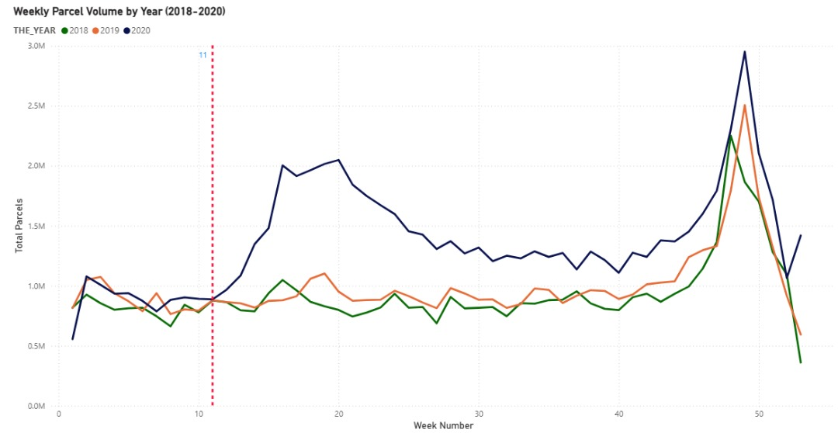
Pre COVID observation: Wk 1-11
Post COVID observation: Wk 12-53
Key Parcel Volume Insights
Pre-Shift: Volumes stable at ≈900K until Week 11 (2020).
The Break: Volume diverged sharply starting Week 12 (Post-Pandemic Declaration).
New Baseline: Sustained 2020 weekly volume doubled the historical rate.
2020 Peak: Record end-of-year peak reached ≈3.0M parcels.

Slide 7
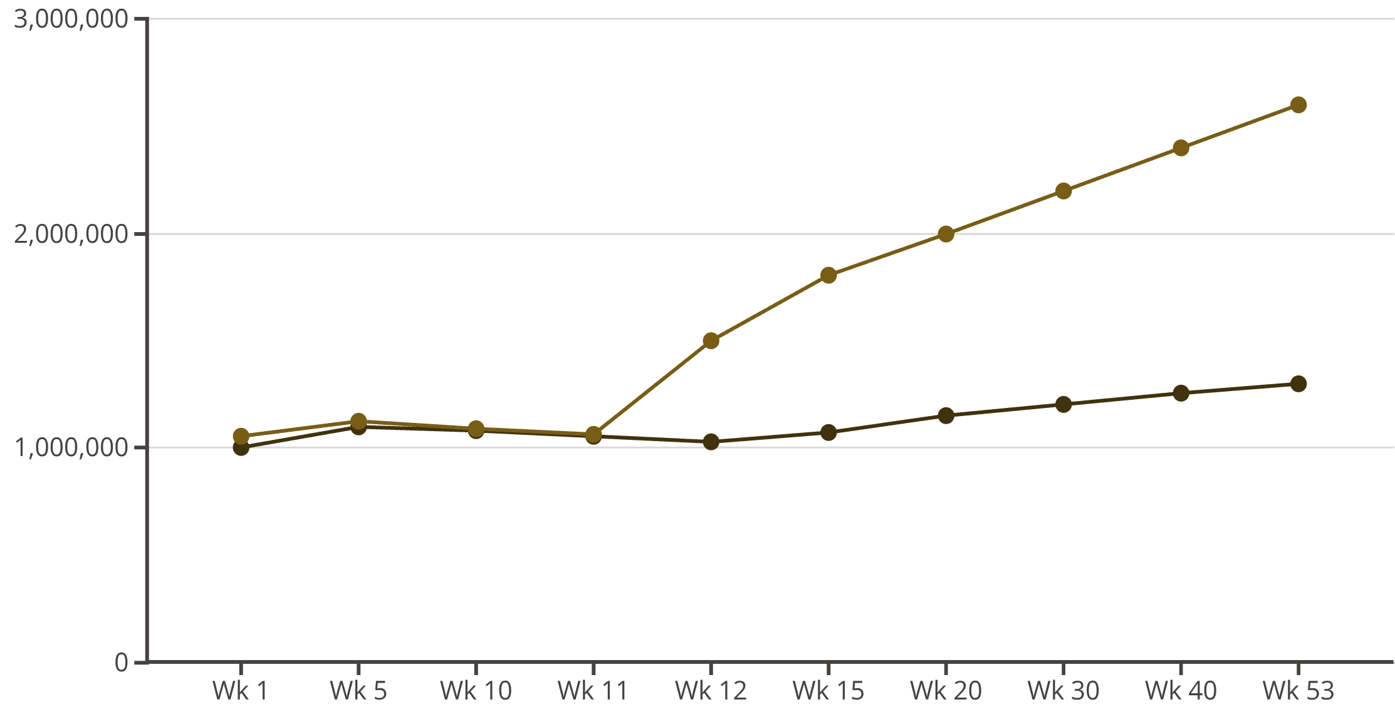
The Inflection Point: When the World Changed
CONCLUSION: Volume sharply increased after Week 11, confirming the pandemic as the direct causal driver.
2019 Volume
2020 Volume
The 2020 Volume line tracked closely to the 2019 baseline until Week 11.
A sustained, high-magnitude divergence began in Week 12 and continued through the rest of the year.

Slide 8
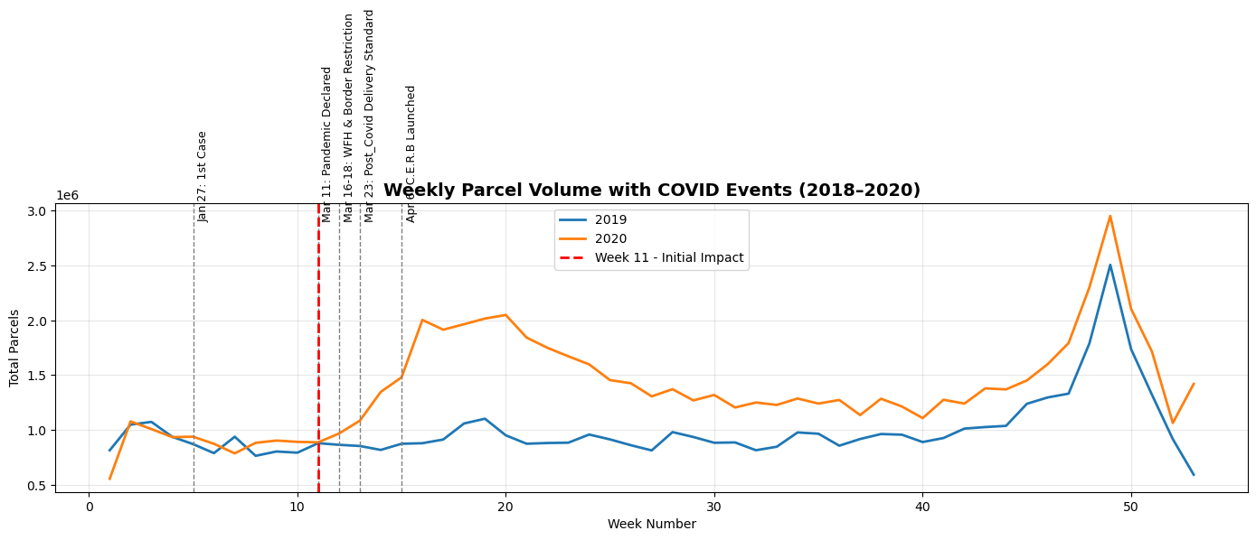
Timeline Summary: Drivers of the 2020 Shift
Week 11 (Pandemic Declared): Triggered initial stockpiling and panic buying, accelerating the volume trend immediately.
Week 12 (WFH/Lockdowns): A massive retail shock led to spending shifting to e-commerce, establishing a sustained high volume baseline.
Week 15 (C.E.R.B.): Government liquidity support sustained the elevated spending, preventing a post-shock volume crash.
Conclusion: A cascade of external shocks permanently accelerated the shift to e-commerce, creating a new, higher operational floor.

Slide 9
External Drivers & Timeline
NARRATIVE: A rapid sequence of events created the operational necessity for our growth.
Week 11 (Mar 11):
1
WHO declares COVID-19 a pandemic. Initial shift in consumer fear/buying.
2
Week 12 (Mar 16):
WFH Mandates & School Closures begin. Key driver of e-commerce adoption.
Week 13 (Mar 23):
3
Emergency Declarations and new Post-COVID Delivery Standards implemented.
4
Week 15 (Apr 6):
Government Income Support (e.g., CERB) programs launched. Sustains online spending.

Slide 10
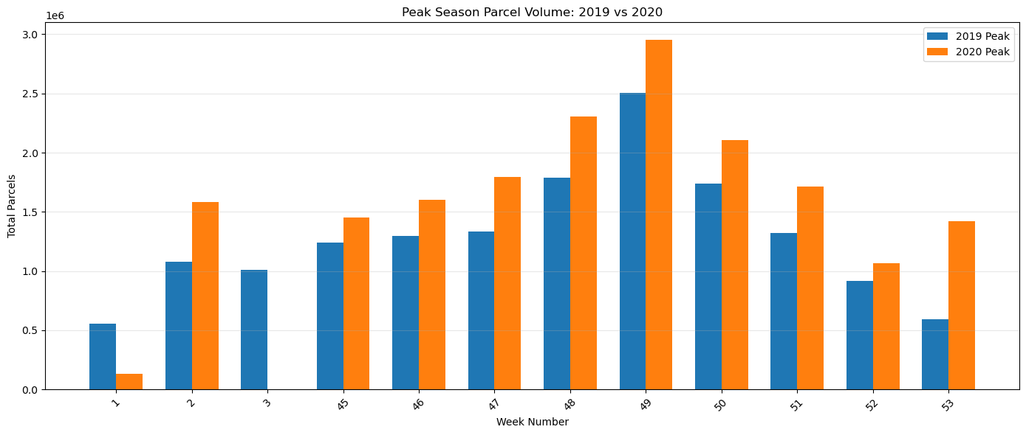
Peak Season & Operational Impact
2020 Volume Surge: 2020 volumes were consistently higher than 2019, confirming that COVID-19 significantly increased peak season parcel demand.
Sustained Demand: 2020 volumes peaked higher and maintained elevated levels longer, reflecting sustained e-commerce adoption during restrictions.
Key Takeaway (Revenue & Planning): Elevated volumes present a clear revenue opportunity, but demand proactive capacity and logistics planning to manage the higher baseline and peak.
Strategic Insight: Expect a persistently higher baseline post-pandemic due to accelerated customer habit formation (Shift to online shopping)

Slide 11
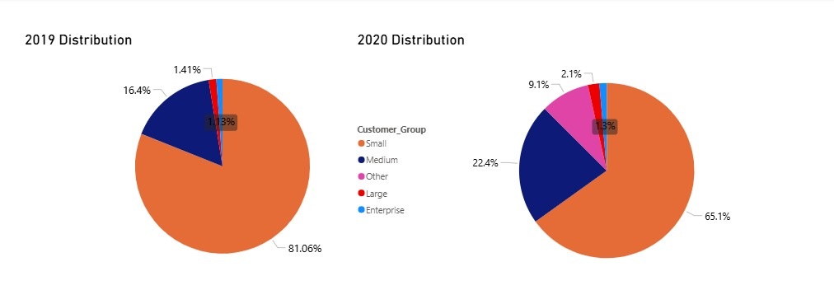
Key Insights from Customer Group Distribution
Small Customers: Experienced a substantial decline (-20.81%), suggesting they were disproportionately impacted by the pandemic (closures/consolidation).
Medium Customers: The largest source of new business, showing significant growth (+34.48%), driving the overall customer base shift.
Large Customers: Saw the highest percentage growth (+46.67%), confirming accelerated volume acquisition in the higher-tier segments.
Strategic Shift: The customer base reshaped toward higher-volume clients (Medium and Large). This indicates ABC's parcel business benefited from more active, larger clients during the pandemic.
Takeaway: This shift confirms the reliance on higher-volume clients for revenue stability and requires prioritizing services for the Medium and Large segments.

Slide 12
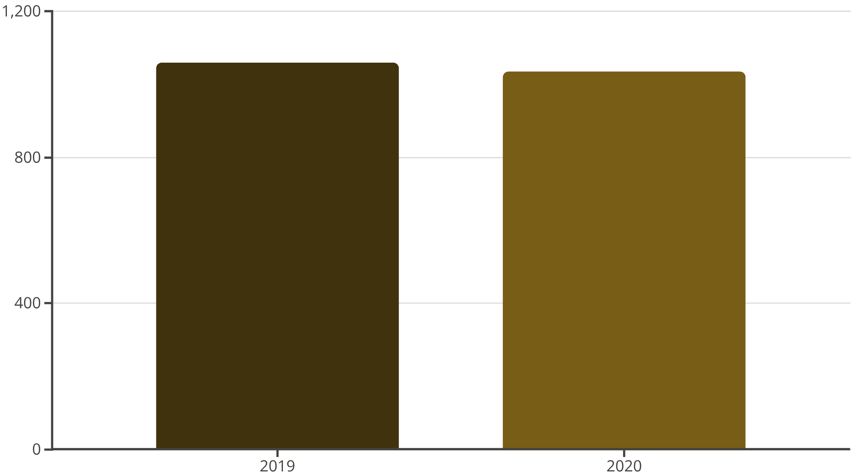
Deep Dive: Customer Base Health
KEY FINDING: While total customers decreased slightly, the new customer acquisition was limited and volatility was high among the 'Other' segment.
Total Lost Customers: Primarily concentrated in the Small and Other segments.
New Customers (0 parcels in 2019): Minimal contribution to overall volume but represent future potential.
The primary challenge is not acquisition, but retaining growth in our existing customer base.

Slide 13
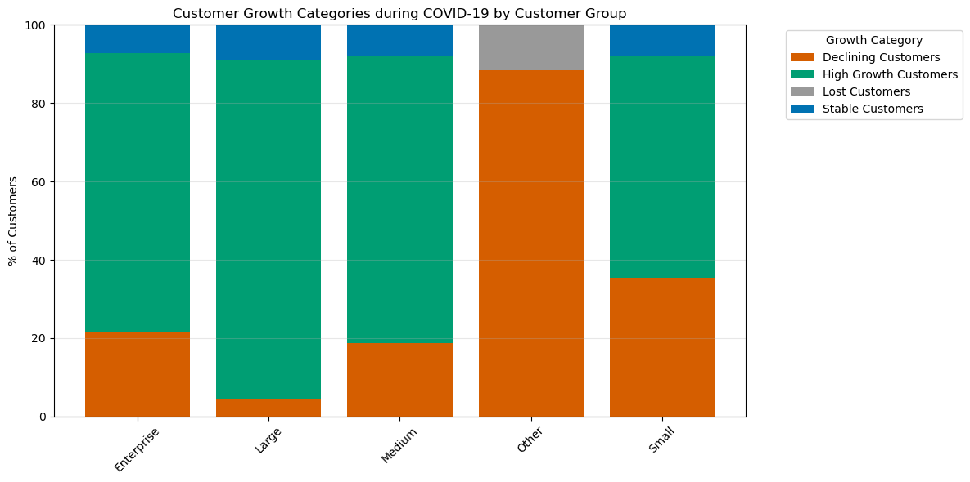
Customer Growth Category Summary
Growth Drivers: Enterprise, Large, and Medium segments were dominated by High Growth Customers (all ≈70%+).
Vulnerability: The Declining customer percentage is heavily concentrated in the Small (≈35% declining) and Other (≈90% declining) groups.
Strategic Insight: COVID-19 significantly favored higher-volume clients, while smaller clients struggled with volume retention.

Slide 14

Customer Group Distribution (2019 Baseline)
INSIGHT: Understanding the starting point (2019) is crucial for assessing segment vulnerability and opportunity.
Enterprise
Large
Medium
Small
Other
Enterprise/Large/Medium customers (the core business) represent the majority of volume and revenue.
Small and Other groups, while numerous, collectively contribute the smallest share of the total business volume.

Slide 15
Q7 What percent of each customer group are new customers during COVID?
There are no new customers in the

Slide 16
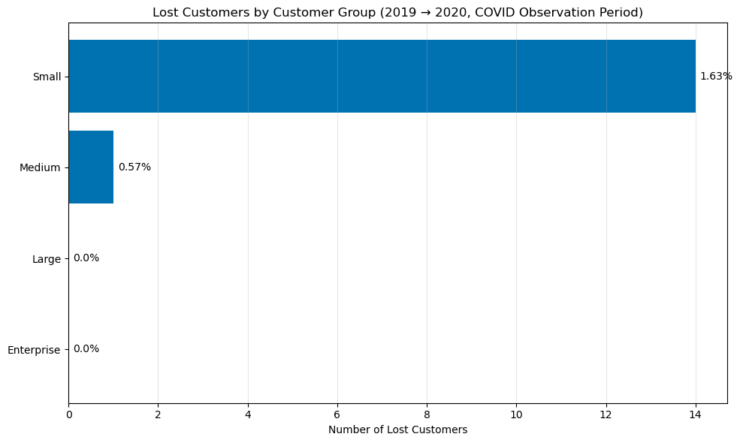

Slide 17
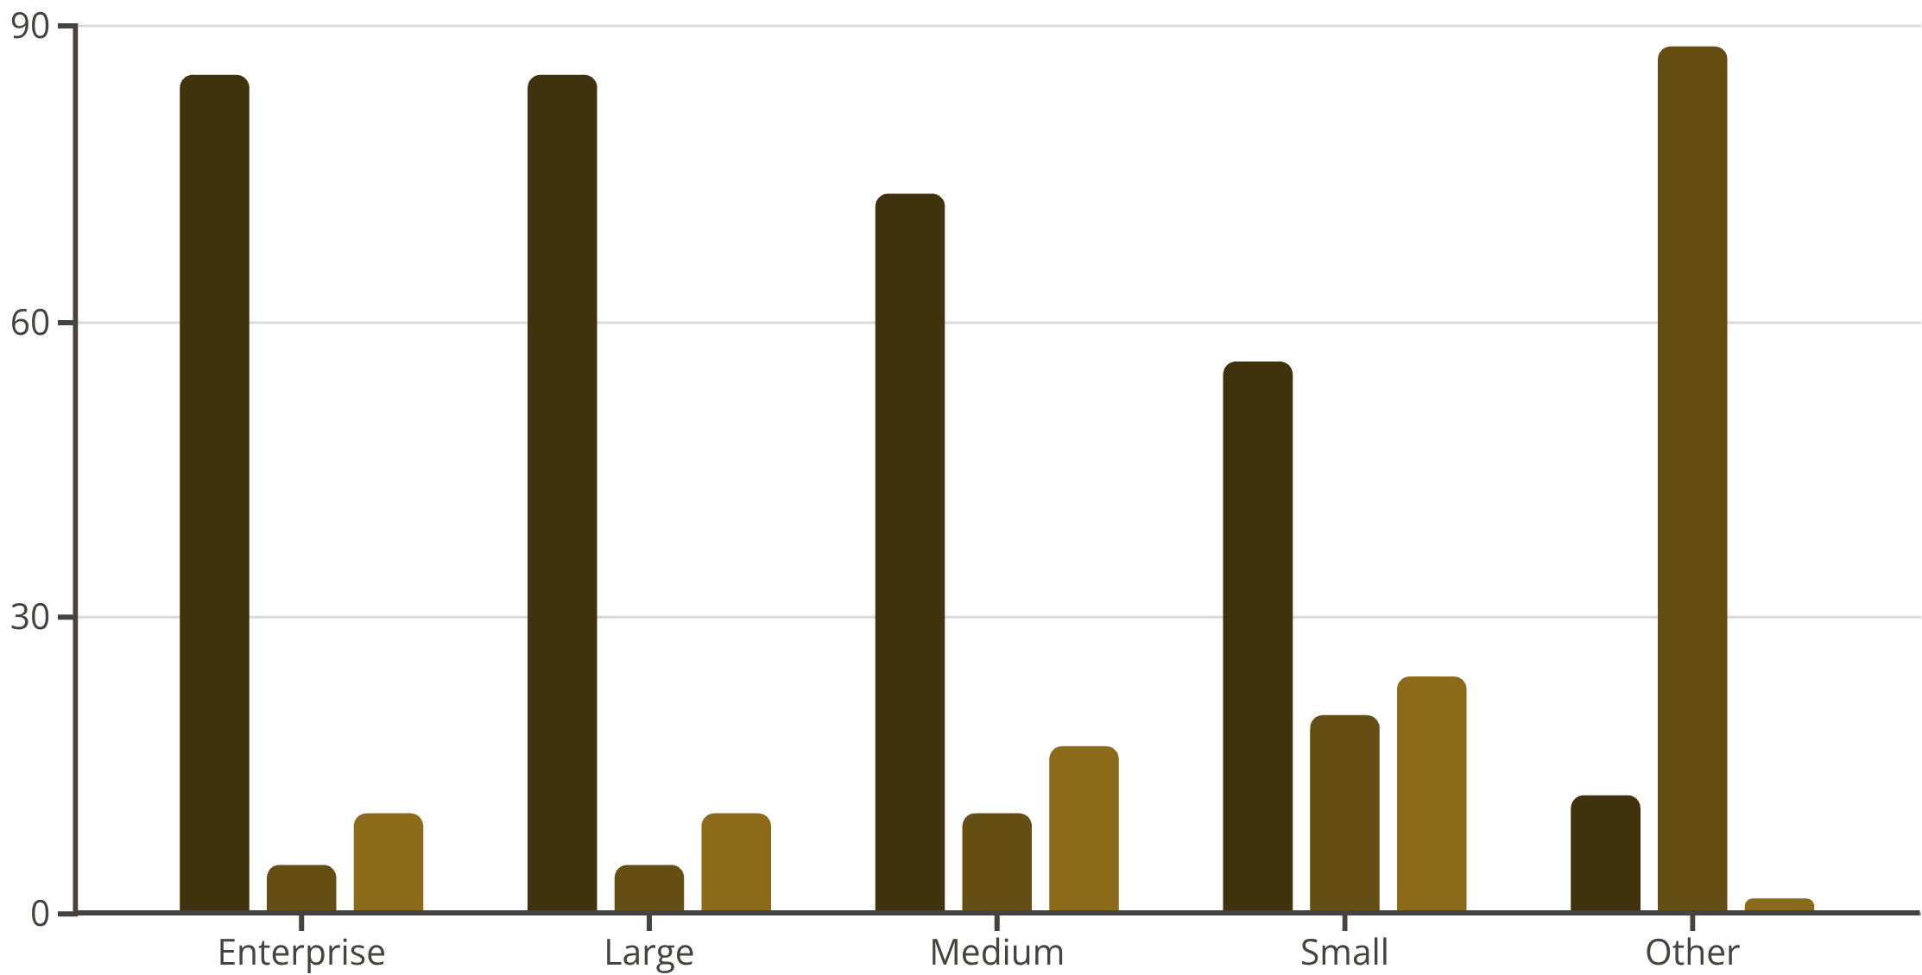
Customer Growth Segmentation (2020 Group Breakdown)
CRITICAL INSIGHT: The Enterprise and Large groups showed exceptional resilience and accelerated growth during the crisis.
High Growth
Declining/Lost
Other Growth Categories
Enterprise/Large: Over 85% of customers in these groups are categorized as High Growth. They successfully capitalized on the market shift.
Small/Other: The Other group had 88% Declining/Lost customers, highlighting extreme volatility and the failure of many small clients to adapt to e-commerce.
Medium/Small: Over 56% of Small and 73% of Medium customers achieved High Growth, validating the success of a broad-market strategy.

Slide 18
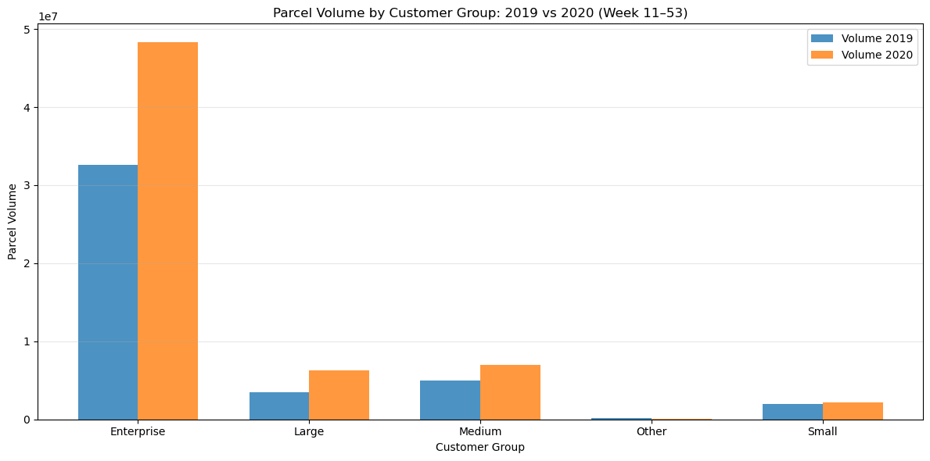
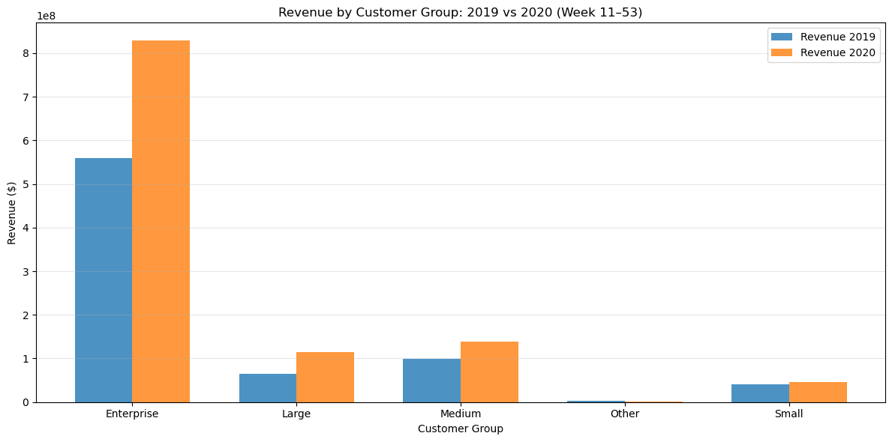
COVID-19 Impact Summary (Week 12–53)
Overall Performance & Initial Shock
Growth: Volume and revenue grew significantly above the normal rate (ISGR = 11.4%), confirming a massive pandemic-driven spike.
Initial Shock: Volume sharply diverged from historical trends starting after Week 11, coinciding with the WHO declaration (Mar 11) and lockdowns (Mar 16/23).
Customer Base Transformation
High-Value Growth: Enterprise and Large customers showed the highest growth and highest revenue contribution.
Medium Segment: Drove significant volume growth and acquired the most new customers.
Vulnerability: Small customers experienced a ≈20% decline (churn/lost customers) and were the most volatile segment.
Key Shift: The pandemic accelerated parcel volumes across all groups, fundamentally shifting the business reliance toward higher-value clients.
Peak Season & Strategy
Record Peak: The 2020 peak season (Wk 45-Wk 2) exceeded 2019 volumes, driven by the sustained pandemic surge.
Strategic Focus: Improving retention of Small customers is key to optimizing overall profitability, while capacity planning must account for the new, elevated peak volumes.

